Slide 1


Real-time Machine Intelligence
Robert Platek | robert.platek@sensorsuite.com
Notes:
Hello my name is Robert Platek, and I’m the founder and CEO of SensorSuite
Thank you for the opportunity to be here today

Slide 2

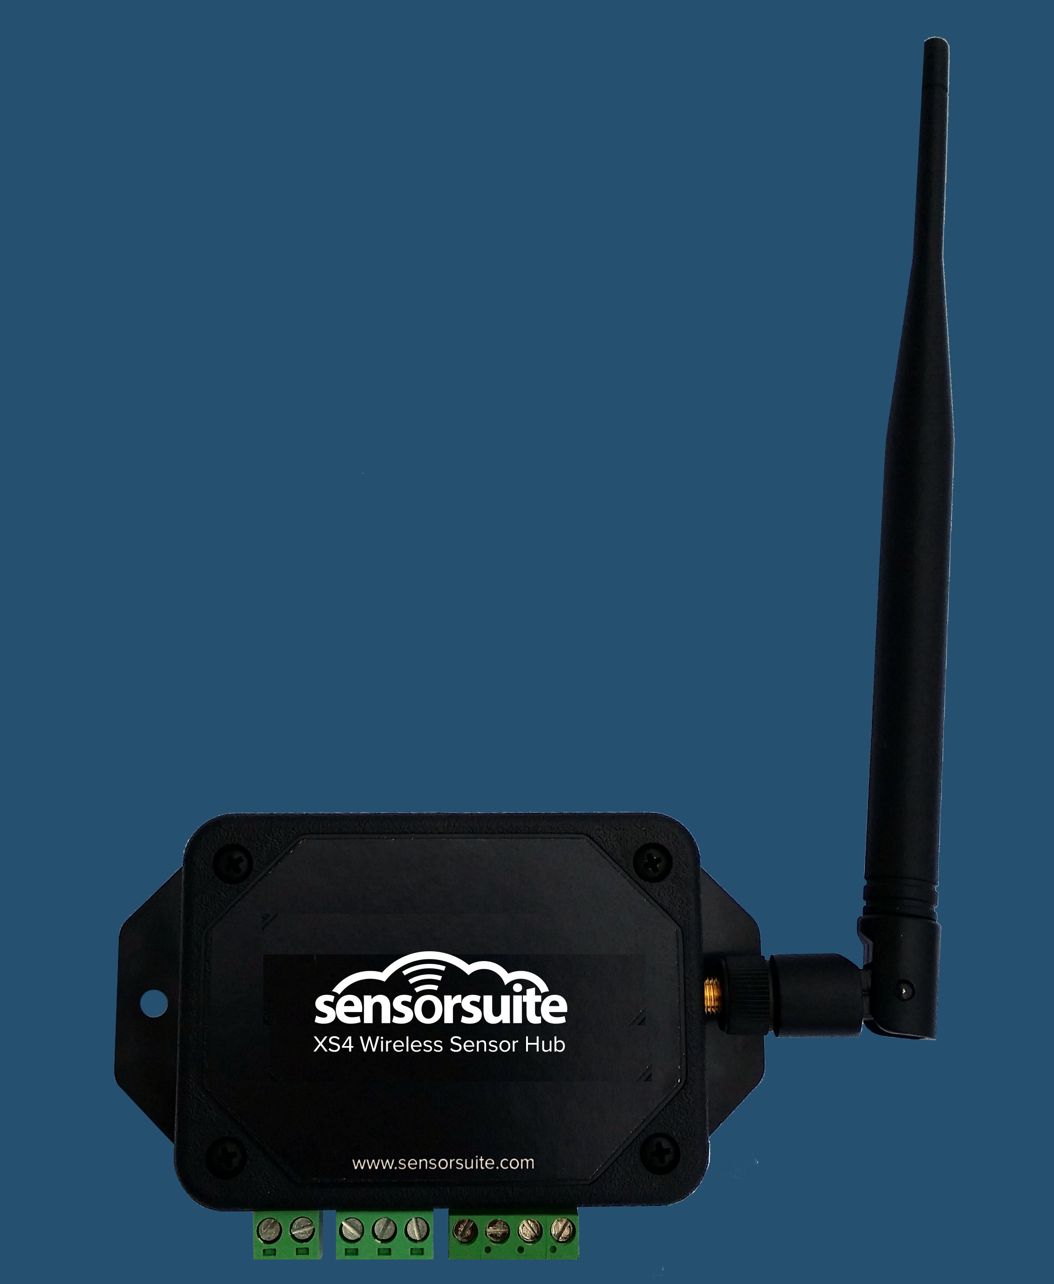
Enabling the Industrial Internet
At SensorSuite, we are committed to the idea that measuring and automating machines results in better business outcomes.
SensorSuite empowers property managers, asset managers, and service providers by providing cloud based, enterprise class wireless sensors and control systems.
We’re looking for $125k to achieve:
Capacity to fulfill orders to Synnex,
Telus, Intellimeter, PLAN and new partners
On-board 10 resellers, 10 sales agents
Achieve $1M+ in sales next year
Notes:
We’re here today asking for 125 thousand in order to fulfill and support orders from our exciting new channel partner opportunities, as well as to grow and be able to capture new opps coming in

Slide 3

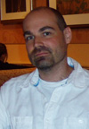
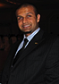
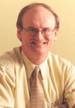
The TEAM
Robert Platek (CEO)
Marc Carignan (CTO)
Vlad Platek (COO)
Salman Habib (CFO)
Co-Founder Experience
Background:
Computer Eng - 20 years software/hardware.
Computer Science 20 years.
Electrical Eng. MBA 40 years.
Commerce and Finance 5 years.
Specialist:
Database technology (DB2) developer at IBM
Cloud software and applications
Building Electrical/Mechanical/HVAC systems
Strategic Partnerships, Digital Media
Experience:
Owner/Business Development at Social Wire Inc
Co-Founder/CEO at Jobdeals Inc. (Jobdeals.com)
Chief Tech Architect (1st employee) at Xprima Inc (Auto123.com)
Head Chief Engineer at RBC
CFO/Business Development at Tapgage
Digital media consultant for 5 years
Notes:
Amazing team
Unique domain experience
We’ve owned and run businesses
Been first employees at successful startups
And headed up large engineering teams at companies like RBC
After 5 years at IBM I joined Vlad’s green energy consulting company
Dragged me into boiler rooms, rooftops, innards of buildings, and we realized it’s wild west
In 2009 I started designing IOT systems, fast forward a few years and here we are today
I’m also the Chairman of the IOT meetup group in Toronto with over 800 members

Slide 4
Unique Technology
Sensorsuite is built on 30+ years of domain knowledge in:
HVAC systems
Low level Embedded System programming
Cloud-based / Big Data systems
Wireless technology
With a 4 year head start on R&D, 30+ buildings and 6+ hardware iterations.
Creating barriers to entry along the way.
Full stack design from hardware to software for a premium user Experience – think Apple.
Setting up exclusive partnerships to create secure channels.
Platform services to create high cost of changing vendors.
Notes:
Traditional companies like honeywell, johnson and others are still mostly wired, expensive and cater to large buildings
Spoke to a top sales guy at Honeywell last week, and he said their analytics platform leaves much to be desired.. He avoids it at all costs

Slide 5
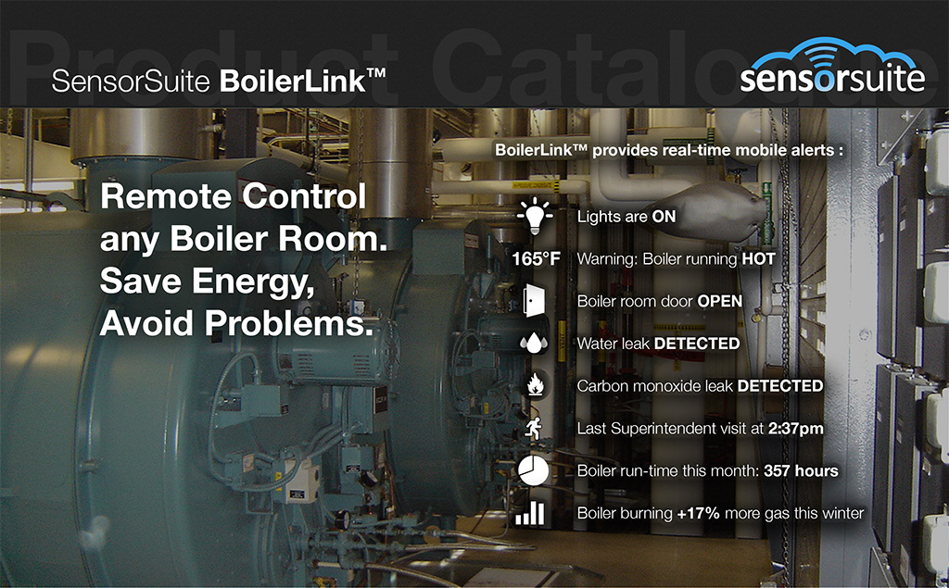
Notes:
Our first paying customer wanted a way to monitor his boiler rooms remotely while out of the country
Sensorsuite enables a digital nervous system that can collect critical data and send it back in realtime to customers
In 2012 we sold him 15 boilerlink systems and he freaked out at us

Slide 6
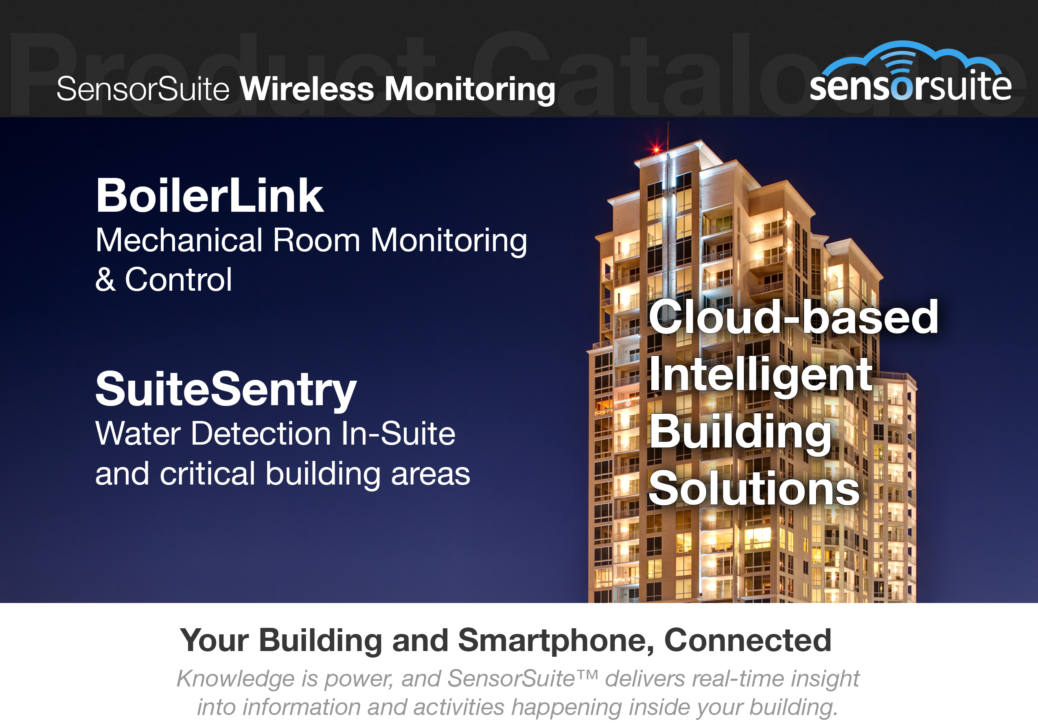
Notes:
We zoomed out a bit, and started discovering other solutions customers wanted
Water damage is a big one
And we’ve also developed energy and water monitoring packages

Slide 7
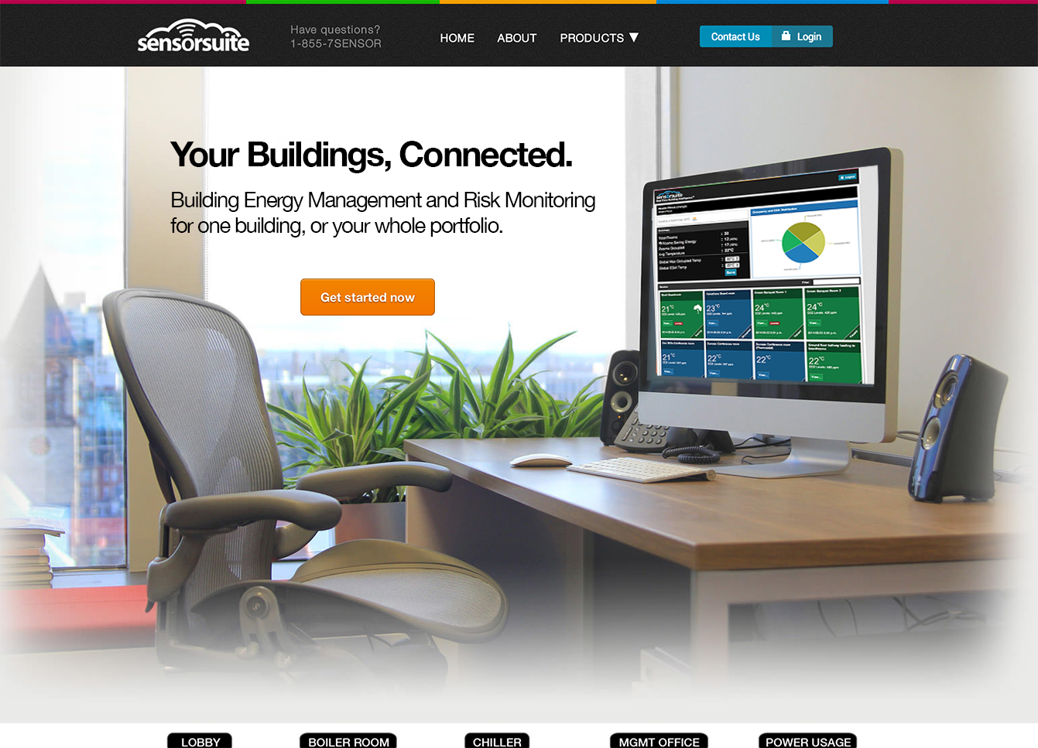
Notes:
At sensorsuite we’ve created a cloud platform where 1 dashboard gives you insight into one building, or your whole portfolio from anywhere in the world
We started as a monitoring company, but quickly realized that customers want to see an ROI, so we added a control solution to our platform

Slide 8
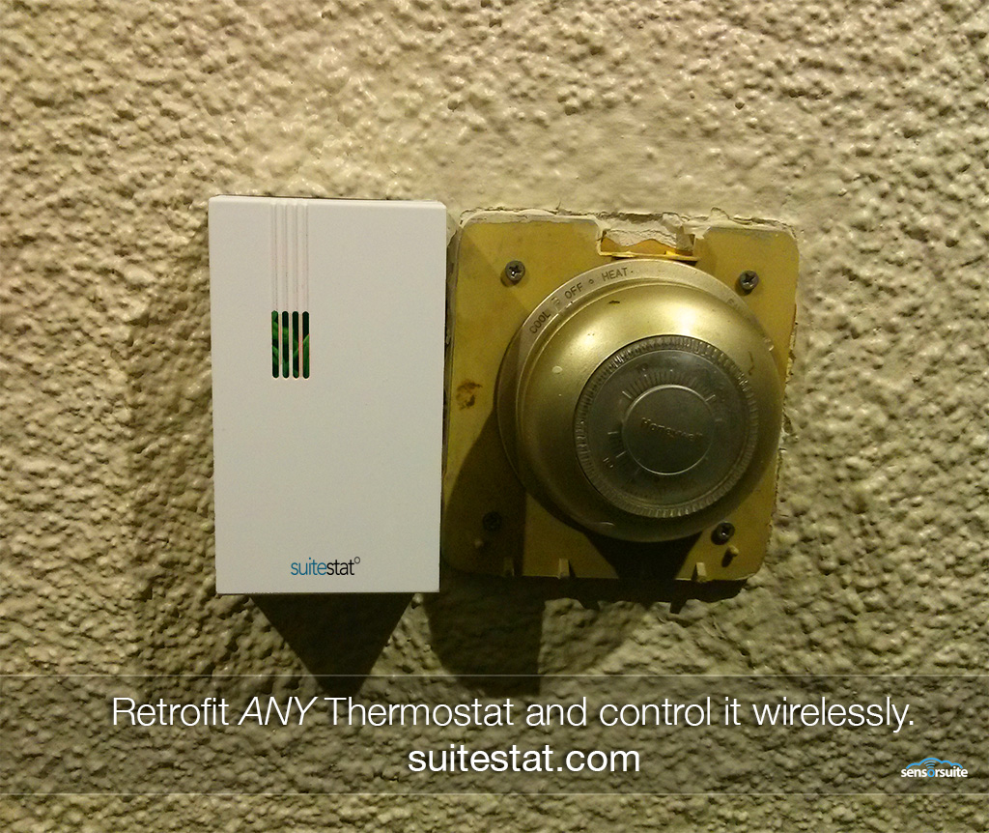
Notes:
We focus on the retrofit building market, there’s thousands of building in this city alone that have no technology in place
Our suitestat smart thermostat takes control of existing thermostats and makes them intelligent

Slide 9
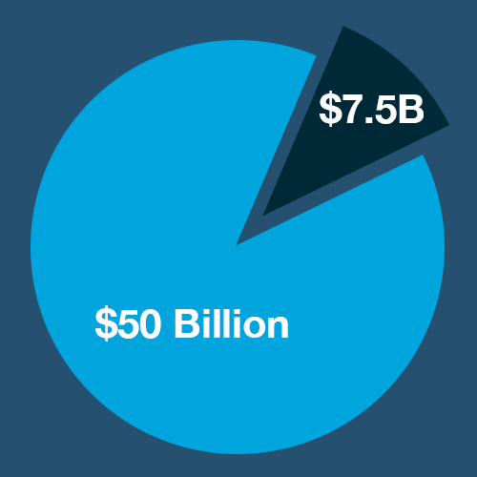
Traction and the Opportunity
The building intelligence and controls
market is projected to be worth
approximately $49.5B by 2018.
TRACTION:
$250k in revenue-to-date from the various projects
30+ Buildings by the end of 2014.
1000+ sensor/control nodes deployed
2 Million Square feet under cloud energy management
200 MILLION data points processed and stored
Notes:
With the small amount of money we’ve raised, we’ve gotten a lot of traction and found product market fit

Slide 10









What’s Next?
Expanding Channel Partnerships
Current Partners:
Synnex (Distribution Partner)
The Plan Group (Integrator Partner)
KD Supply
Intellimeter
Future Partners:
Telus M2M
Verizon M2M
Current Sales:
Timbercreek Asset Management
Town Inn Hotel
20 proposals in sales pipeline
Notes:
Working on really exciting partnerships which will help us scale and capture market share
Talk about goto market
Technology – de-risked → 25+ successful test projects
Market – de-risked → Signed agreement with channel partners

Slide 11
Key Learnings from Customers
Sales Channel Strategy:
Direct sales will not help us scale this business, there is a heavy capital cost to operational development.
Reseller Program:
Empowering integrators/resellers to carry our products/solutions will help minimize the heavy costs of employing integrators during our growth stages.
Many customers already have established relationships with contractors
Shortening Sales Cycle:
To shorten our sales cycle, we’re introducing small pilots to
allow customers to be able to touch and feel the solution.
OnSite Installation Innovation
Plug and play system
An industry leading software tool to simplify the commissioning process using mobile devices
Notes:
There have been many key learnings from customers

Slide 12
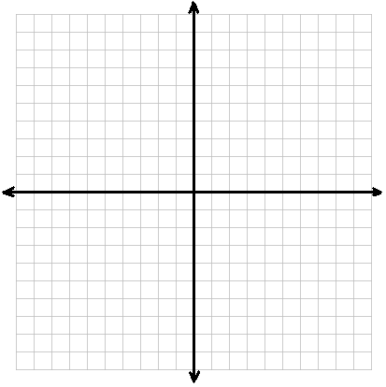










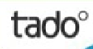

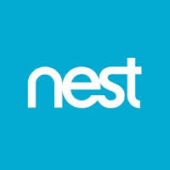


Competitor Comparison
Business to Business Solutions
Connected Home
Smart-Building
Software Platforms
Energy Efficiency
Consumer Solutions
Notes:
Competitor landscape
Lots of action in the consumer space, Nest, Ecobee, Smart things and others
Sensorsuite is an industrial internet company focusing on Internet of things business solutions

Slide 13
Use of Funds
Achieving Sales of $1M (50k)
We will hire a Sales Manager to help us refine and begin closing potential opportunities in our pipeline and add new opportunities. Part of the fund will be used for marketing.
Signing and Training 10+ Resellers ($25k)
We will hire a Sales/Channel manager to help us refine our reseller package and sign new resellers. Part of the fund will be used for marketing.
Singing and Training 10+ Sales Agents (25k)
We will hire a Sales/Channel manager to help us refine our reseller package and sign new resellers. Part of the fund will be used for marketing.
Production and Manufacturing (25k)
Focused on setting up inventory management solutions and systems.
Notes:
With your help today we hope to expand our team

Slide 14
Resulting In…
Achieve $1M in new revenue and give us the capacity
to fulfill to these new channel partners
Synnex
Telus
The Plan Group
IntelliMeter
New Partners
Establish channels
10+ resellers
10+ sales agents
10+ sales consultants.

Slide 15
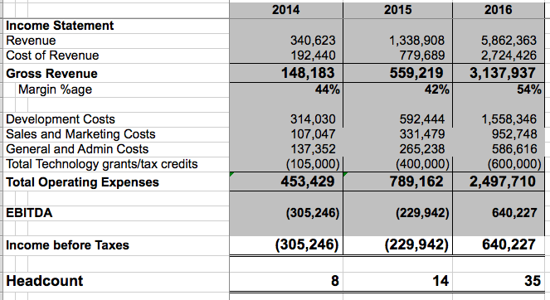
Projections
Notes:
We’re projecting about 1 to 1.3 million in revenue next year
Which will set us up for a strong 2016 as we bring on new resellers and channel partners
We project 6MM in revenue in 2016

Slide 16




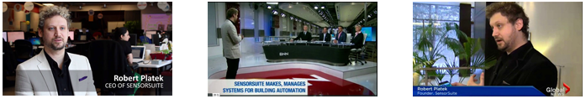
Media Love
Notes:
-we've spent alot of time on the technology and sales aspects of the business
but I've also paid close attention to positioning sensorsuite as a leader and authority
in the emerging IOT industry
Our work has attracted lots of media attention, the biggest being the Gartner Cool Vendor award

Slide 17
Big Things On the Horizon
US opportunities with KD Supply (600 restaurants)
Telus launching IOT store and we’re going to be one of their first partners (National Launch)
Synnex invite to speak at reseller conference
SensorSuite will enable the new PLAN group HQ
with our sensors
Notes:
In summary, there’s a lot of big things on the horizon
We’re a team focused on execution, and in the next month alone we have these exciting things happening
Going to UTAH next week to install a pilot they’re very excited about.. They want to start with 600 restaurants (1 chain) and then expand to a potential of 7000 more
Telus is launching an innovative store next month
We want to be able to capture and execute on all this exciting business coming our way, and ask for your support today, thank you!

Slide 18
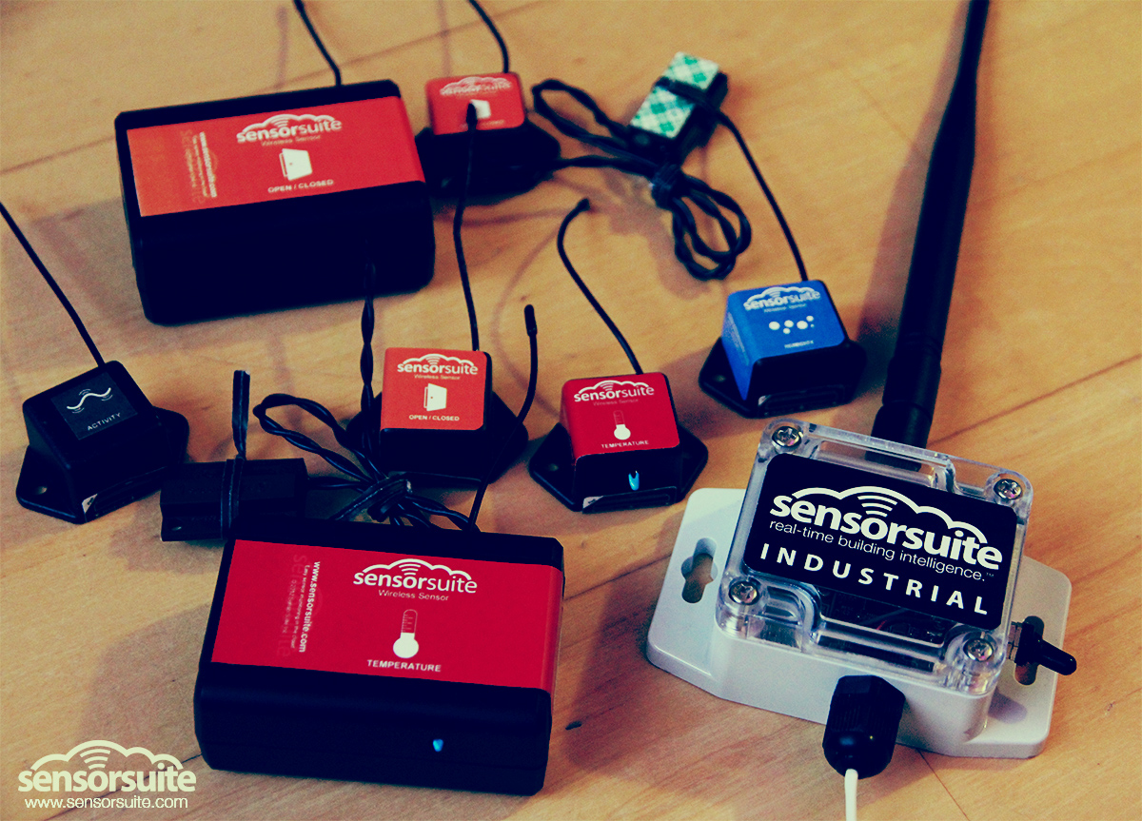
Thank You!
www.sensorsuite.com
@sensorsuite

Slide 19
IP
Spoke to our IP lawyer last week:
We’ve definitely done patent searching to make sure we're not
re-inventing the wheel
There are other sensor companies out there, and freedom to
operate should not be an issue.
if every company worried about this, there would be no innovation
unique aspects of technology, we're not aware of any IP at the moment
looking to file patents that differentiate us with norton rose
we will do freedom to operate analysis down the line, 30-40k to do
this analysis
Notes:
This is a company about execution and grabbing market share

